Slide 1
2014 Ball Shooter

Slide 2
Background
A quick CAD model was created that can be used to optimize the geometry.
The CAD model has 2 configurations, a ball loading one and one where the ball is being released.

Slide 3
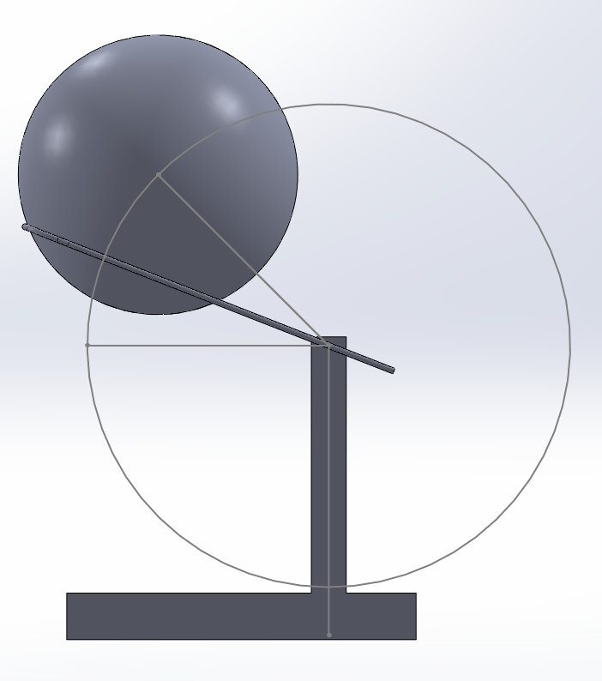
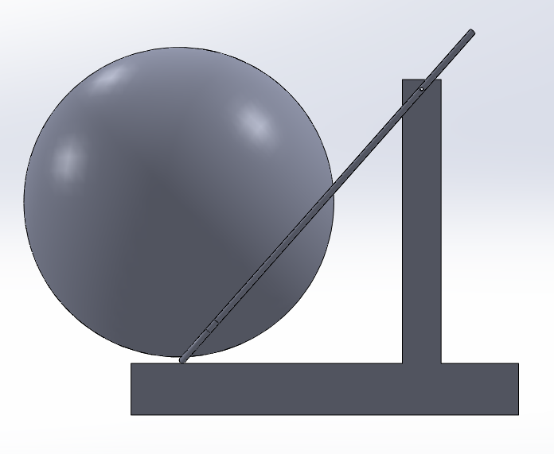
Model

Slide 4
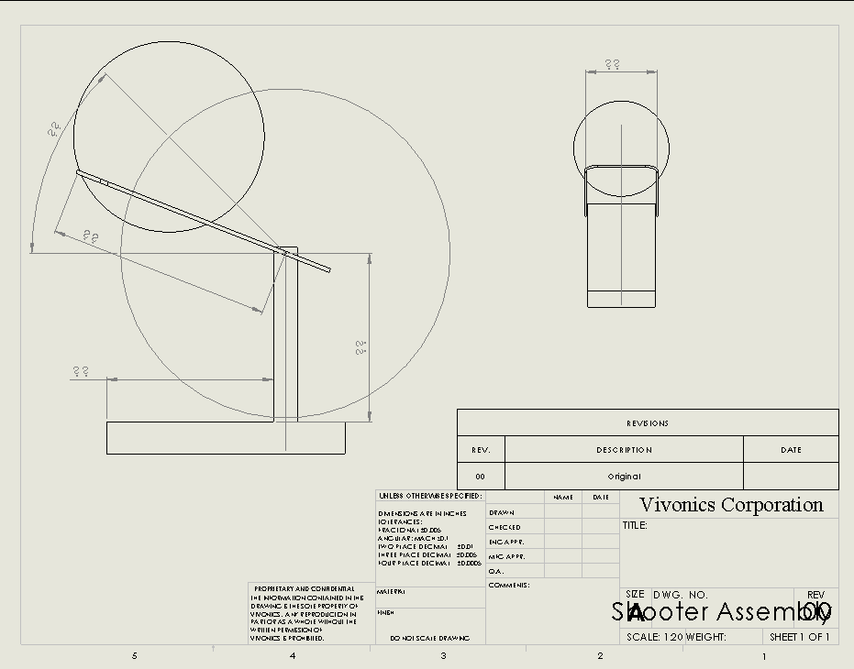
Necessary Model Inputs

Slide 5
What the Model Can Tell You
Whether the ball will fall out before shooting.
What angle the ball needs to be released at.

